Slide 1
Electricity bill system
Group_No :- 08
2020icts62
2020icts25
2020icts22
2020icts55
2020icts46

Slide 2
This project purpose is calculate the electricity bill according to the user need

Slide 3
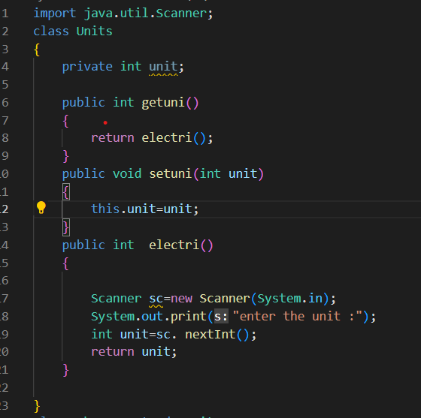
Class Units
This class use for get the unit from the user.

Slide 4
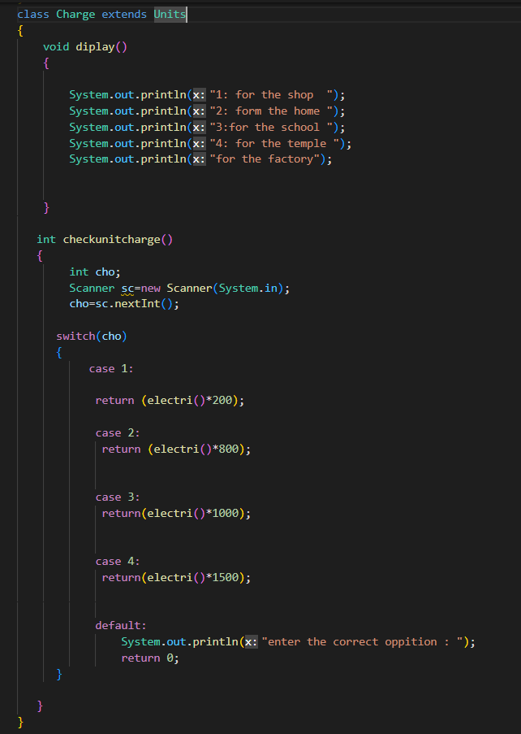
Class Charge
This class child of Units.
Display the menu for User.
User can select one Billing Calculation.

Slide 5
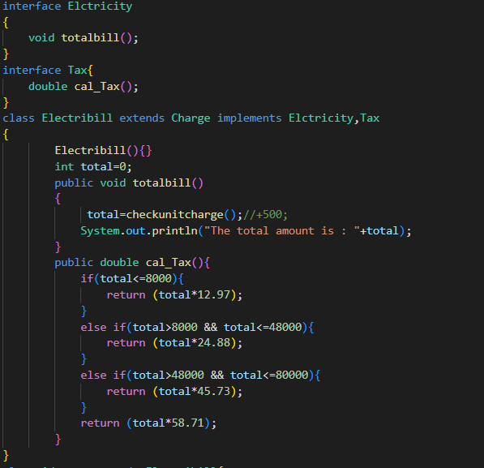
Class Electricity
Print the total bill with tax

Slide 6
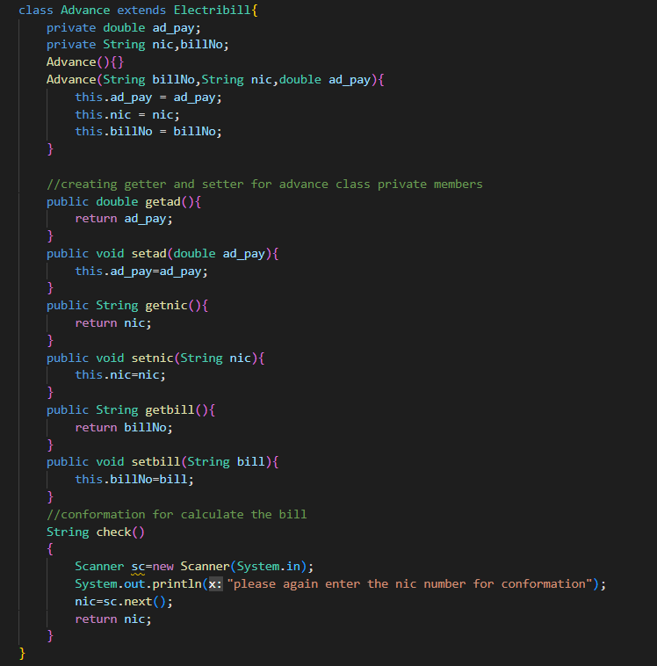
Class Advance
Get the input from the user get the bill number and NIC.
Check the NIC value .

Slide 7
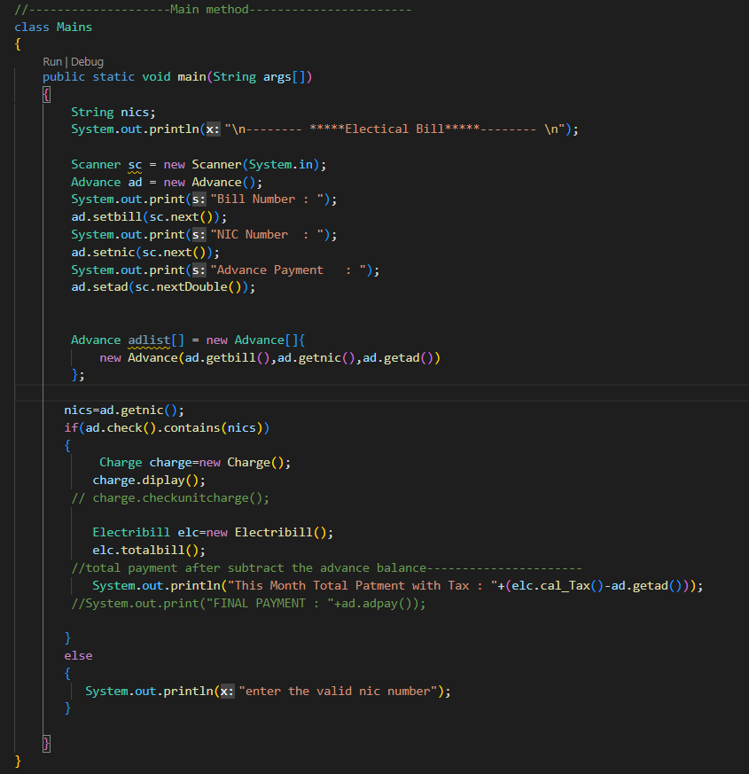
Class Main
Call the classes , method in all the main method.

Slide 8
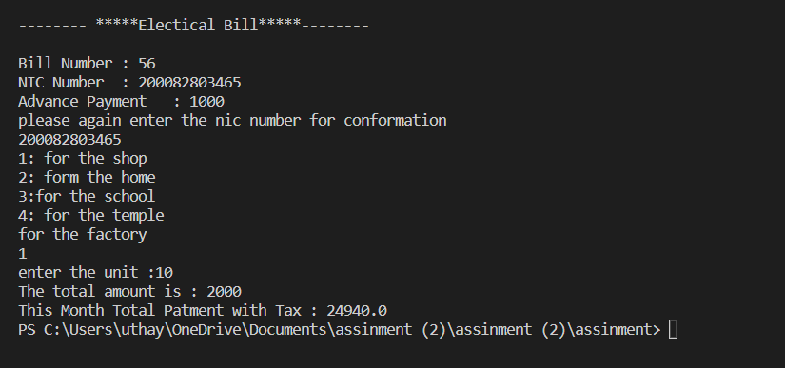
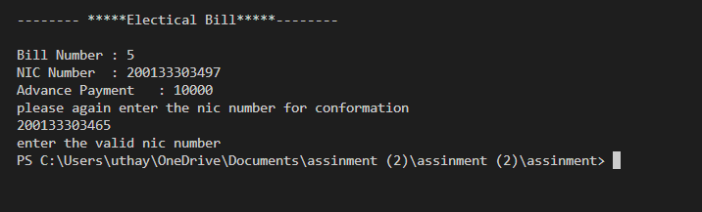
OUTPUT
Figure 1 is correct output.
Figure 1
Figure 2 is incorrect output.
Figure 2

Slide 9
THANK YOU

